Slide 1
College Board: Creating Your College List
College Prep
Mr. Gordon
jgordon@bisdtx.org

Slide 2
Upcoming Events

Slide 3
What to consider when choosing a College:
Location- Do you want to attend a school close to home, in Texas, or maybe in
New York?
Size- Do you want a large school (50,000) or a small school (1,000)?
Program/ Degree Offerings- Does the university have your major?
Cost

Slide 4
College Board: Creating Your College List
Using the criteria on the previous slide, we are going to create YOUR College List.

Slide 5
College Board: Creating Your College List
When applying for colleges your senior year, you should plan on
applying to 3-5 universities.
For this activity, you will add six to your College Board list. If you did this last year, I want you to do more research into the universities you chose.

Slide 6
College Board: Creating Your College List
Ask yourself:
What do I like about this school?
Can I plan on visiting it this year? (see next slide)
Does it have my major? Find the degree plan for that major.

Slide 7
College Board: Creating Your College List
Juniors get TWO excused absences when visiting universities this year.
There is a form in the Google Classroom. You just need to let your teachers know you will be absent and then have a representative from the university sign the form.
You should plan on doing your visits on a Friday.

Slide 8
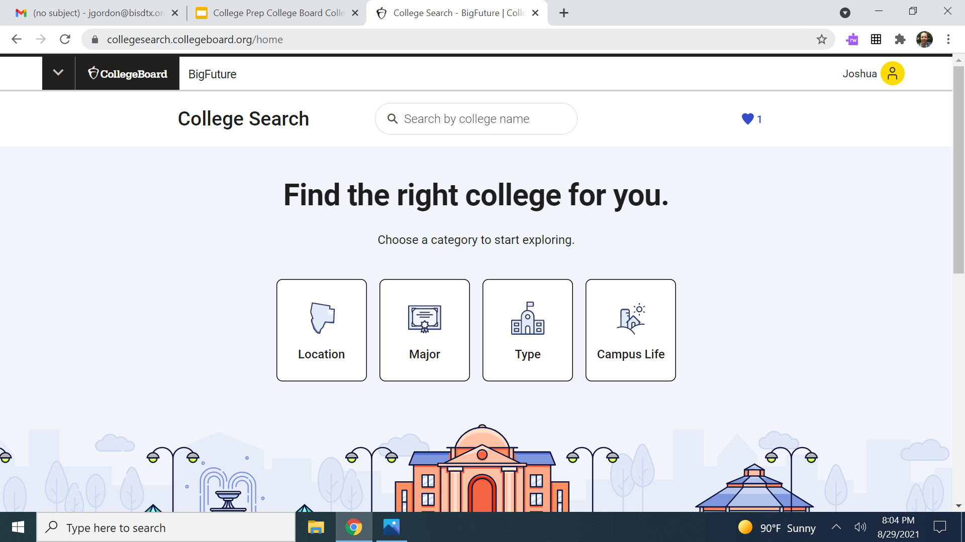
College Board: Creating Your College List
Go to College Search - BigFuture and sign in.

Slide 9
College Board: Creating Your College List
Using the four categories, search for colleges.

Slide 10
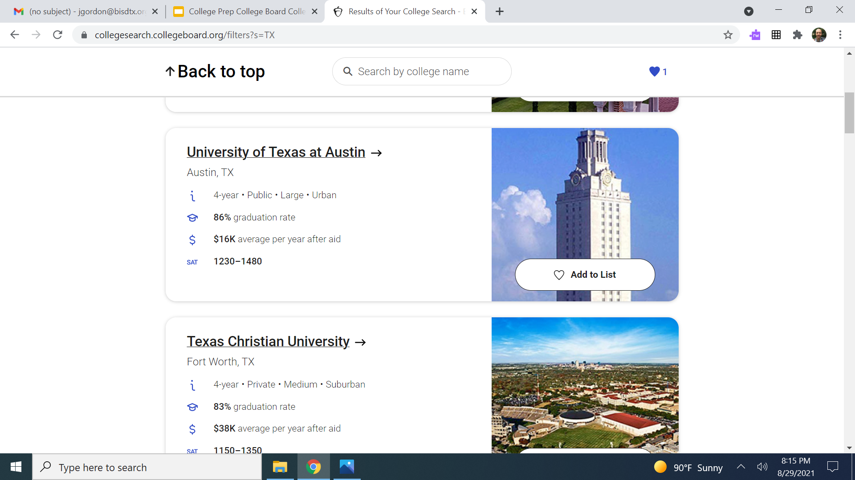
College Board: Creating Your College List
When you find a university you are interested in, add it to your List.

Slide 11
Today’s College Prep Assignment
In the comments section of today’s College Prep,
write two colleges that you added to your list and
WHY you chose them.

